Slide 1
Verification & Validation
OPER 561 Discrete-Event Simulation
Lesson 13
Notes:
Using: student handout for V&V activity; Excel file with output data; midterm study guide

Slide 2
Lesson objectives
Differentiate between verification & validation
Learn statistical approaches to validation
Validate a simulation model using outputs and historical data

Slide 3
Verification & Validation
Verification
Validation
Validation activity
Notes:
> Chi Sq on Excel vs. the formula table

Slide 4
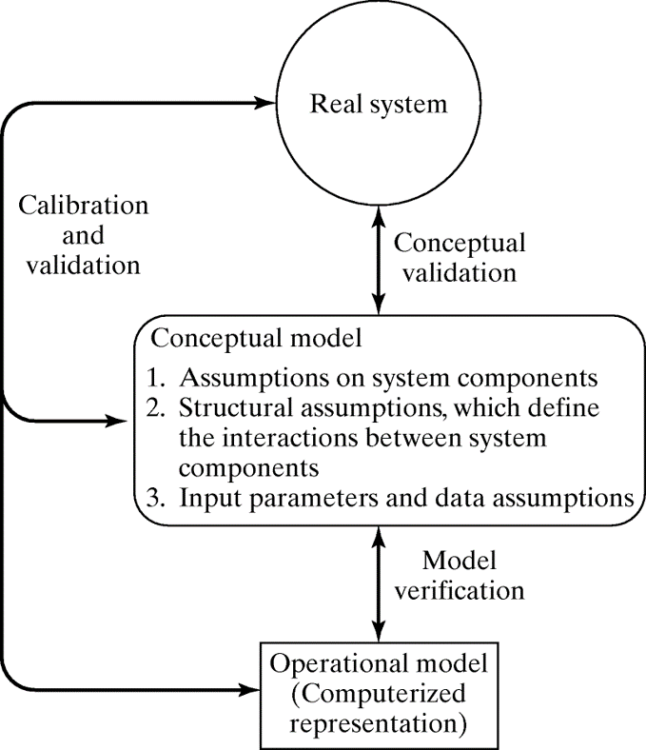
Verification & Validation (V&V) occur throughout the simulation project
Goal: produce a credible model
V&V is a largely subjective process With some stats!

Slide 5
Verification ensures the conceptual model is accurately reflected in the computer model
Did you build the model right?
Some common-sense techniques:
- Have someone else check your work - Explain your model to someone else - Build a flowchart for all actions - Check output under a variety of inputs
Notes:
Checking the reasonableness of simulation outputs is easy but often overlooked. If one value is unusual, check related values—an error rarely affects exactly one output.

Slide 6
Verification is where animation is so valuable Not just pretty pictures anymore
Related: model trace
Do entities move (or don’t) as intended throughout the process?
Are resources & servers busy/idle at the proper times?
Do state variables change when expected, as reported by status labels?
Notes:
Trace: detailed printout of state of simulation over time; similar to animation (use it to look for entity flows, interactions, resource util., etc.)

Slide 7
Writing documentation for your model clarifies its logic and helps verify its completeness
If you can’t describe your model in complete sentences, you’re likely missing something

Slide 8
Verification & Validation
Verification
Validation
Validation activity

Slide 9
Validation compares the constructed model and its behavior to the real system
Did you build the right model?
As in, does the model reflect the real-world system that you are trying to simulate?

Slide 10
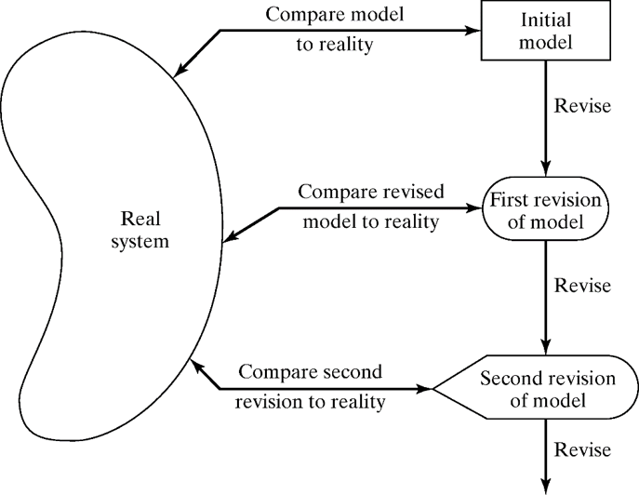
Calibration is the iterative process of comparing & making adjustments
Notes:
The point here is that validation isn’t a yes/no result, but a process. You want to avoid rejecting a model outright, but instead work to revise it.

Slide 11
Consider this three-step approach for simulation model validation
1. Build a model that has high face validity
2. Validate the model assumptions
3. Compare input-output transformations of model & real system data

Slide 12
High face validity is when a model looks reasonable “on its face” to SMEs & analysts
1. Face validity
2. Assumptions
3. Input-output
In other words, the model is built with a high degree of realism
Involving potential users throughout the simulation project can help with face validity
Some sensitivity analysis can provide insight Does changing inputs have expect effects?
Notes:
E.g., MAJ Kennedy’s UAV model

Slide 13
Structural and data assumptions are central to model development, but error-prone
1. Face validity
2. Assumptions
3. Input-output
Consider a bank simulation:
The numbers of queues & tellers and the queuing discipline are structural assumptions Validate by talking to SMEs, observing bank
Service times & arrival rates during the day are data assumptions Validate input models via SMEs & stat. tests
Notes:
SMEs may include bank managers
Stat. tests here are re: Input Modeling lesson

Slide 14
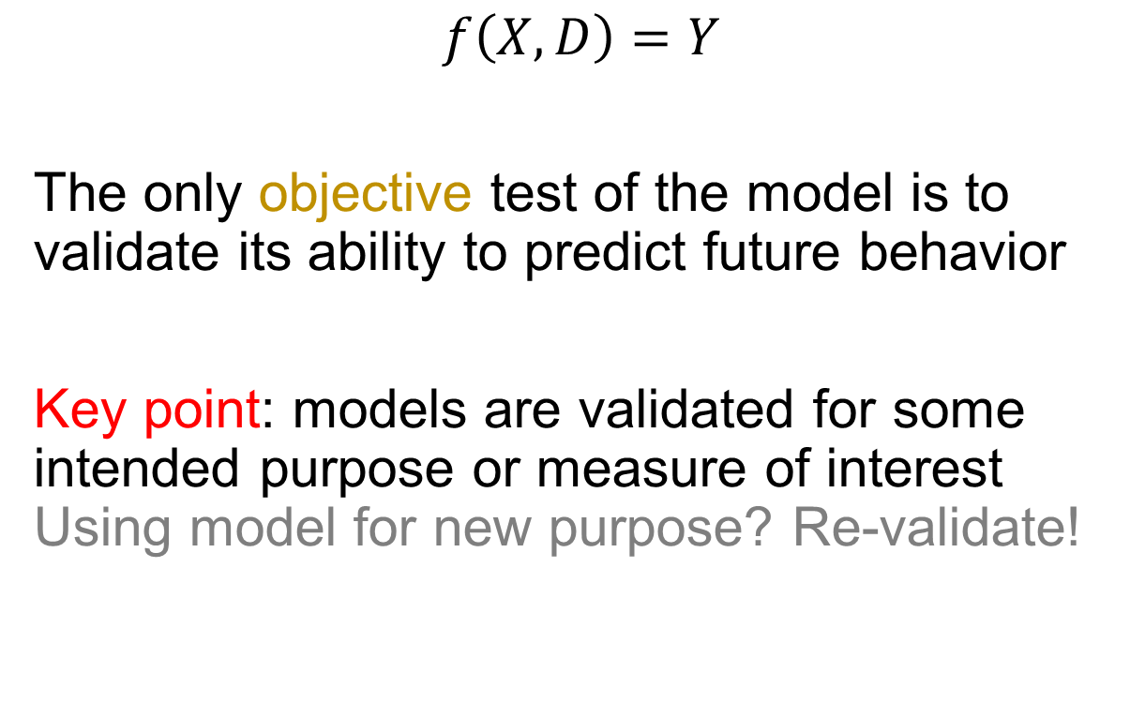
A model is a mechanism for transforming inputs into outputs—and so is the real world!
1. Face validity
2. Assumptions
3. Input-output
$$f\left(X, D\right)=Y$$
The only objective test of the model is to validate its ability to predict future behavior
Key point: models are validated for some intended purpose or measure of interest Using model for new purpose? Re-validate!
Notes:
f – the “black box” of your model
X – uncontrollable inputs
D – decision variables
Y – outputs

Slide 15
Real system data is necessary for input-output transformation validation
If you had to build input models without data, then focus on face validity & assumptions
Consider setting aside data for only this test See also: train/test data in AI/ML/regression

Slide 16

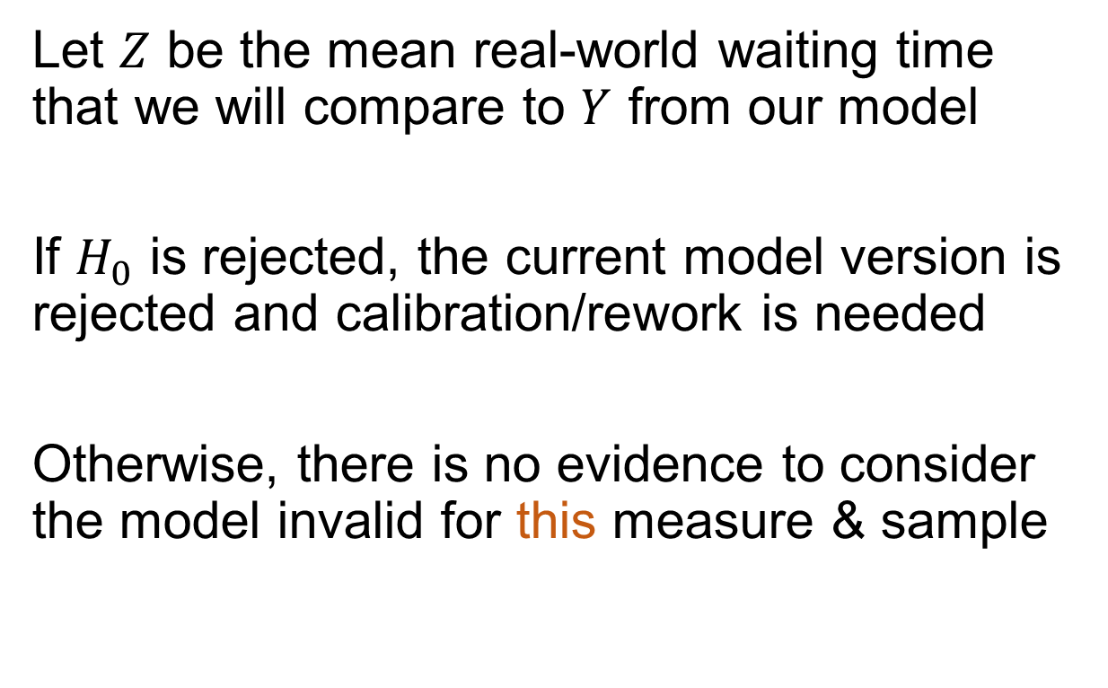
Hypothesis testing lets us validate input-output elements in a statistical way
$$H_{0}:E\left(Y\right)=Z$$
$$H_{a}:E\left(Y\right)≠Z$$
Let $Z$ be the mean real-world waiting time that we will compare to $Y$ from our model
If $H_{0}$ is rejected, the current model version is rejected and calibration/rework is needed
Otherwise, there is no evidence to consider the model invalid for this measure & sample
Notes:
Similarly, compare input-output transformations for other measures of interest

Slide 17
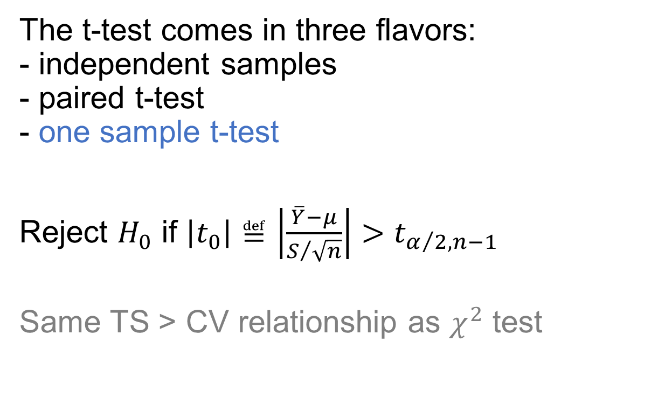
For comparing means, the t-test is often the appropriate statistical test to use
The t-test comes in three flavors: - independent samples - paired t-test - one sample t-test
Reject $H_{0}$ if $\left|t_{0}\right|≝\left|\frac{\overline{Y}−μ}{S/{\sqrt{n}}}\right|>t_{α/2,n−1}$
Same TS > CV relationship as $χ^{2}$ test
Notes:
One sample t-test is right for this Others will be used in later weeks
Example t-test on p. 403?

Slide 18
Confidence interval testing is philosophically equivalent to hypothesis testing via a t-test
The hypothesis test tries to answer if the simulation and real system are the same
Confidence intervals try to assess if the simulation and real system are close enough The analyst decides how close that may be
Notes:
BCNN talks about Type I/II error & statistical power at this point (p. 405).

Slide 19
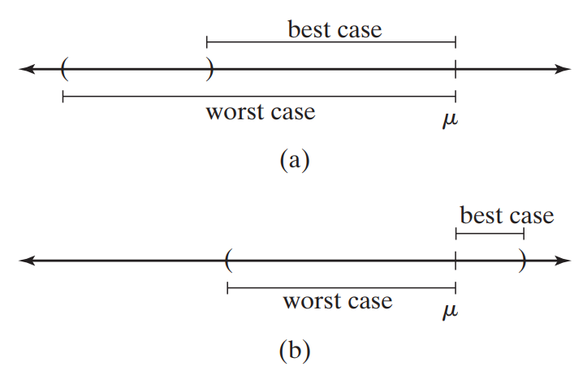
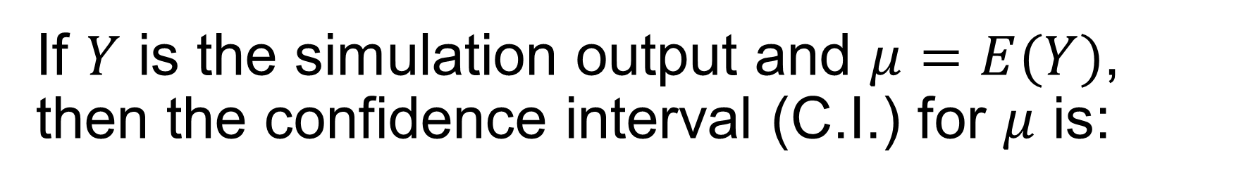

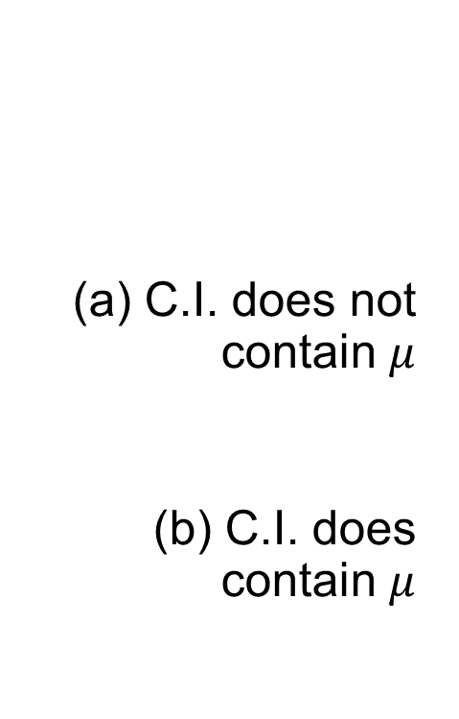
If $Y$ is the simulation output and $μ=E(Y)$, then the confidence interval (C.I.) for $μ$ is:
C.I. does not contain $μ$
(b) C.I. does contain $μ$
$$\overline{Y}±t_{\frac{α}{2}, n−1}\frac{s}{\sqrt{n}}$$
Notes:
Case (a):
If best-case > eps, refine model
If worse-case < eps, accept model
If best-case $≤$ eps, run additional replications
Case (b):
If either best- or worst-case > eps, run additional reps
If worst-case $≤$ eps, accept model

Slide 20
When validating input-output transformations, consider using raw historical data
E.g., instead of creating arrivals using a fitted distribution, use the actual historical record
That removes randomness and “fitting error” from the arrival process, but is data-heavy And incurs all the costs that come with data

Slide 21
The Turing Test approach replaces a stat. test with SME judgement and experience
This is useful if no statistical test is feasible
Give a SME reports from the real system and the simulation (formatted equally)
If they can identify the “fake” reports, interview to get info for model improvement
Notes:
Else, conclude that the test gives no evidence of model inadequacy

Slide 22
Verification – did you build the model right? Validation – did you build the right model?
Any mnemonics to keep them separated?

Slide 23
Verification & Validation
Verification
Validation
Validation activity
Notes:
2 files in Canvas files/activity files for L13
Student handout (may have paper handout)
Excel file

Slide 24
Verification & Validation
Verification
Validation
Validation activity
Notes:
HW 2 review – computing endpoints of pieces? May roll in to exam review.

Slide 25
Lesson objectives
Differentiate between verification & validation
Learn statistical approaches to validation
Validate a simulation model using outputs and historical data

Slide 26
Learning outcomes: At the end of this course, students will be able to:
LO 1. Construct or modify a simulation model in response to a system description using discrete-event simulation methodology.
LO 2. Differentiate between important and trivial sources of randomness or variability in real-world processes.
LO 3. Describe the theory behind popular random variate generation techniques and understand how they are implemented in computer simulation.
LO 4. Analyze the output of a computer simulation to estimate system performance parameters.
LO 5. Evaluate alternative system designs using simulation.
LO 6. Carry out the process of model verification and validation.

